Slide 1

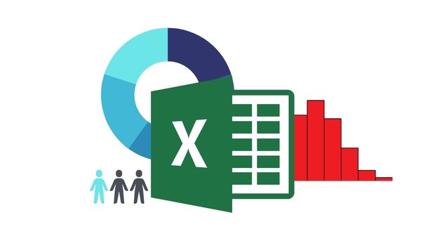
Hiring Process Analytics
Created by- Mainak Mukherjee
Email- subha.mainak@gmail.com

Slide 2
-:Project Description:-
The hiring process is a pivotal aspect of a company's long-term success. It requires a careful assessment of various factors to ensure that the recruitment not only benefits the organization but also contributes to the growth and development of the individual. This hiring analytics project aims to provide a comprehensive analysis of the hiring trends and patterns within our company, leveraging data-driven insights to optimize the recruitment process.

Slide 3
-:Objectives:-
Gender Distribution of Hires: We need to determine the proportion of male and female hires to understand the gender diversity in the company.
Average Salary Analysis: We need to calculate the average salary offered to new hires to assess the company's compensation trends.
Salary Distribution: Creating salary class intervals to analyze the distribution of salaries and identify any disparities or trends.
Departmental Distribution: Visualizing the proportion of employees across different departments to understand departmental growth and resource allocation.
Position Tier Distribution: Analyzing and represent the distribution of different position tiers within the company to understand the hierarchy and growth opportunities.

Slide 4
-:Approach:-
Our approach to the hiring analytics project involved a structured methodology to systematically analyze and interpret the recruitment data. The process was executed in several key steps, using specific techniques and tools within Microsoft Excel to ensure comprehensive and accurate insights.
Data Preparation:
Data Collection: Gathered the dataset containing the following columns: application ID, interview date, status (hired/rejected), gender, department, post name, and offered salary.
Data Cleaning: Ensured the dataset was free of errors, such as missing values, duplicates, and incorrect data types, to maintain data integrity.
Gender Distribution Analysis: Applied filters to the 'status' column to select only the 'hired' candidates. Counting Hires by Gender: Utilized the ‘=COUNTIFS’ function to count the number of male and female hires. Also analyzed it using pivot table and visualizing through Bar Chart.
Average Salary Calculation: Created a Pivot Table to calculate the average salary offered to hired candidates and visualized through Bar Chart.
Salary Class Intervals Creation: Created a Pivot Table to analyze salary distribution and visualized through Bar Chart.
Departmental Distribution Visualization: Inserted a Pivot Table to summarize the count of hires in each department. Selected the Pivot Table data and inserted a Pie Chart to visualize the distribution of hires across departments.
Position Tier Distribution Representation: Inserted a Pivot Table to count the number of hires in each tier. Selected the Pivot Table data and inserted a Bar Chart to represent the distribution of positions across different tiers.

Slide 5
-:Tech-Stack Used:-
Software: Microsoft Excel [Office Professional Plus 2021]
Purpose:
Data Collection and Cleaning
Data Analysis
Pivot Tables
Data Visualization using Bar Chart and Pie Chart
By leveraging Microsoft Excel 2022, we were able to efficiently prepare, analyze, and visualize the hiring data, leading to actionable insights and informed decision-making regarding the company's recruitment strategies.

Slide 6
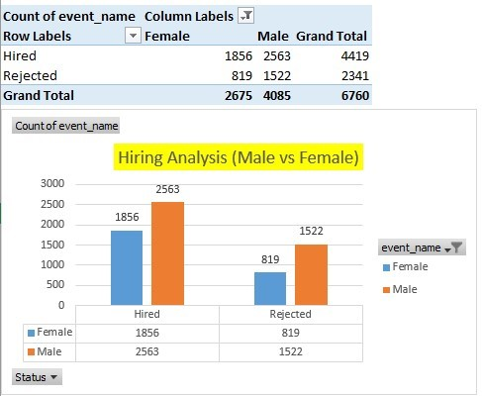

Hiring Analysis
Task:- Determine the gender distribution of hires. How many males and females have been hired by the company?
Using Excel Formula:-
Male- =COUNTIFS(C:C, "Hired", D:D, "Male")
Female- =COUNTIFS(C:C, "Hired", D:D, “Female")
Using Pivot Table

Slide 7
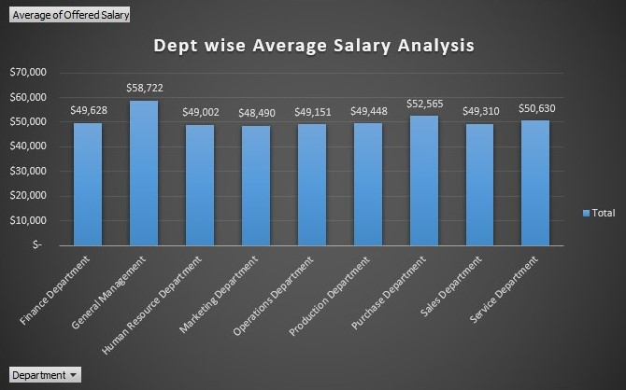
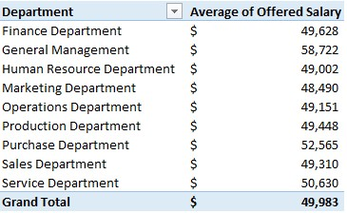
Salary Analysis
Task:- What is the average salary offered by this company?

Slide 8
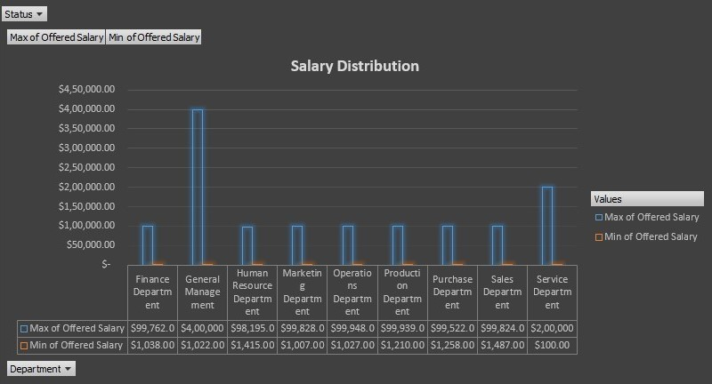
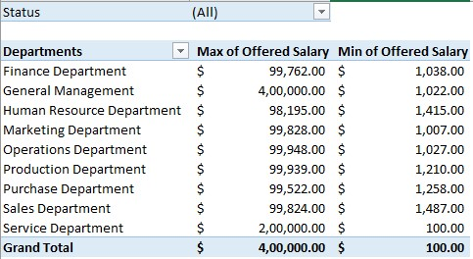
Salary Distribution
Task:- Create class intervals for the salaries in the company.

Slide 9
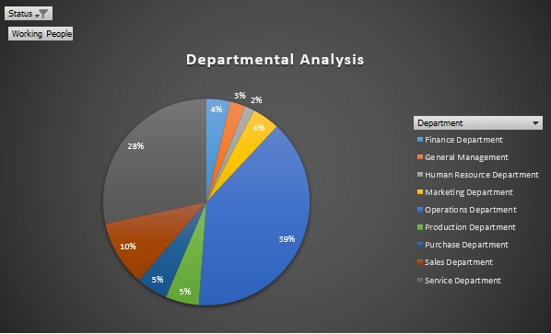
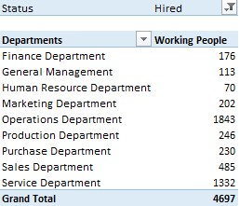
Departmental Analysis
Task:- Show the proportion of people working in different departments.

Slide 10
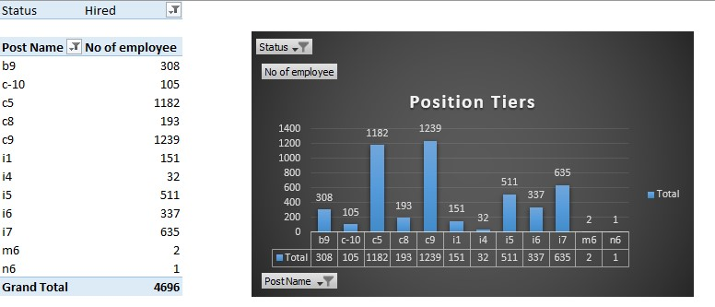
Position Tier Analysis
Task:- Use a chart or graph to represent the different position tiers within the company.

Slide 11
-:Results Summary:-
Total Males Hired- 2563 Total Females Hired- 1856 Overall Average Salary- $49,983
Through the execution of the hiring analytics project, we achieved several key insights that have significantly contributed to our understanding of the hiring process within the company. The detailed analysis and visualizations provided us with actionable information to enhance our recruitment strategies and ensure a balanced, data-driven approach to hiring.
Enhanced Decision-Making: The project provided a data-driven foundation for making informed decisions regarding hiring strategies, salary structures, and departmental focus areas.
Identification of Trends and Patterns: Analyzing the hiring data allowed us to identify key trends and patterns, such as the balance in gender distribution and the concentration of salaries in specific ranges.
Resource Allocation: Understanding departmental growth helped in planning resource allocation and identifying departments that may require more recruitment efforts.
Strategic Planning: Insights from the position tier distribution supported our strategic planning in terms of career development and growth opportunities within the company.
Overall, this project has significantly enhanced our understanding of the hiring process analytics, enabling us to optimize our recruitment practices and promote a diverse, equitable, and growth-oriented workplace.

